Slide 1
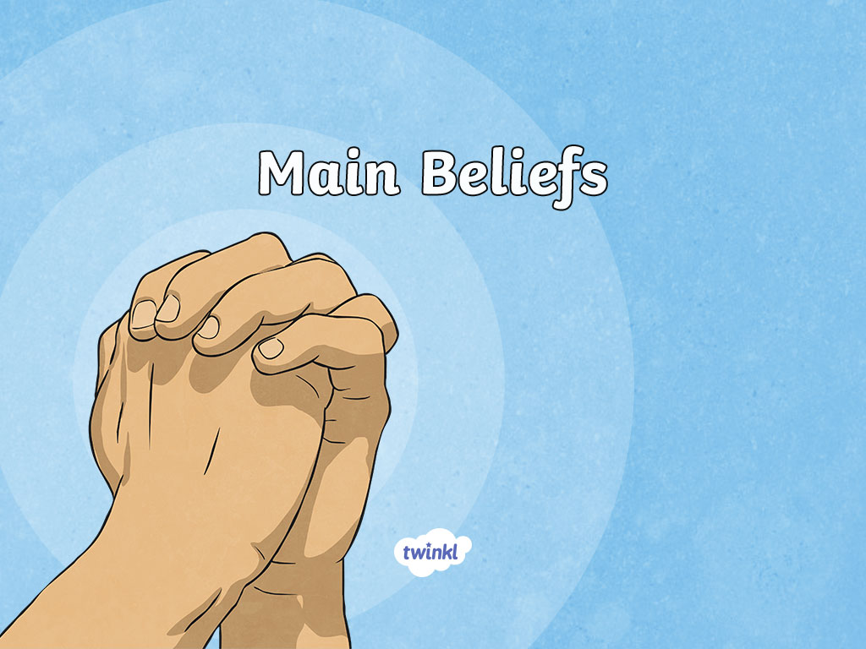

Slide 2
Learning Objective
To explain the main beliefs of Christianity
Success Criteria
You will name some of the main beliefs linked to Christianity
You will be able to give an example to show your understanding of the trinity
You will create a drama scene to show your understanding of one of the Ten Commandments

Slide 3
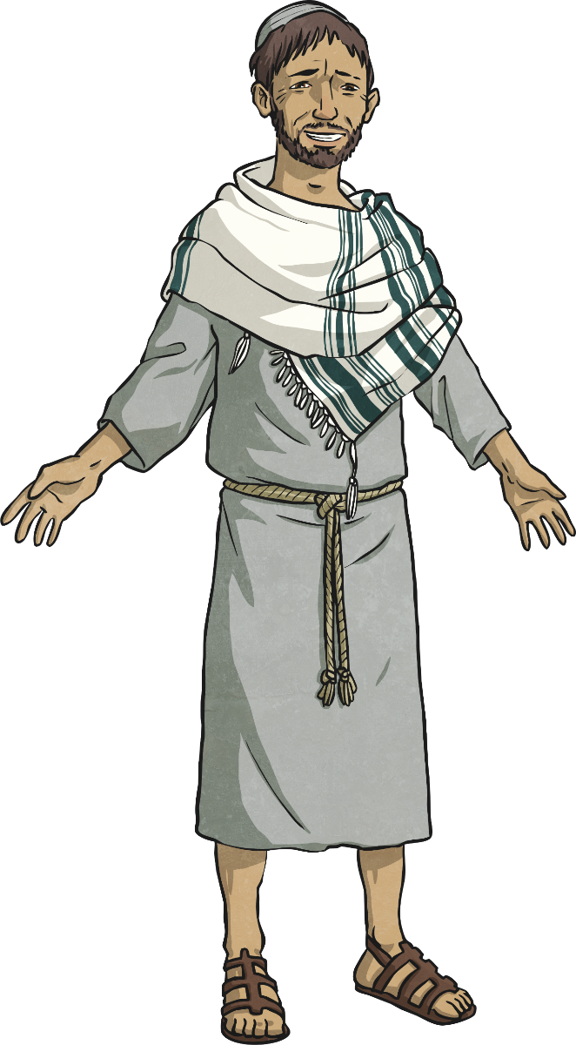
Beliefs
Christians believe:
That God made the world
That God gave the Ten Commandments for people
to live by
That Jesus is the Son of God
That Jesus was sent to save people from their sins
That Jesus was the Messiah who had
been promised in the Old Testament
In the ‘Trinity’

Slide 4
Jesus
Who was Jesus?
Christians believe Jesus was fully human.
Why is this important to Christians?
Jesus being fully human meant he lived a life being vulnerable as other humans do and felt pain in the same way as other humans.
Jesus was crucified and died on the cross.
Jesus rose from the dead on the third day.
As Jesus was fully human, his torture before his death would have caused him pain. This is significant for Christians because Jesus’ suffering is what they believe frees them from sin
– he took the burden of their sin.

Slide 5
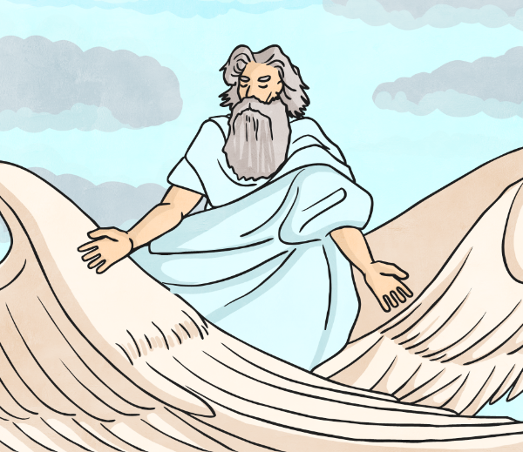
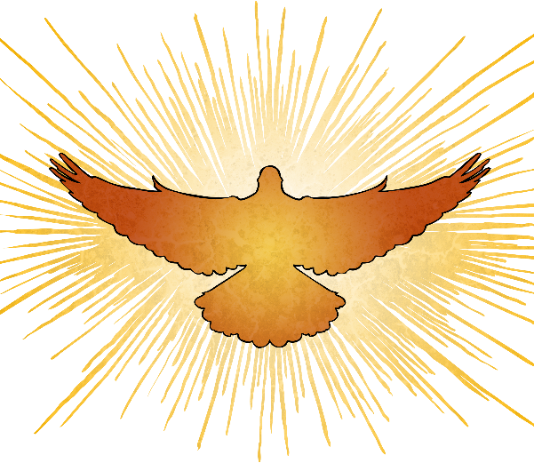
Beliefs
Christians believe in one God.
However, Christians believe that God is 3 separate but constant persons:
Father
Son
Holy Spirit
Christians believe that God is Father, Son and Holy Spirit quite separately but all at the same time. This is called the Trinity. To some people this can be quite a confusing idea.

Slide 6

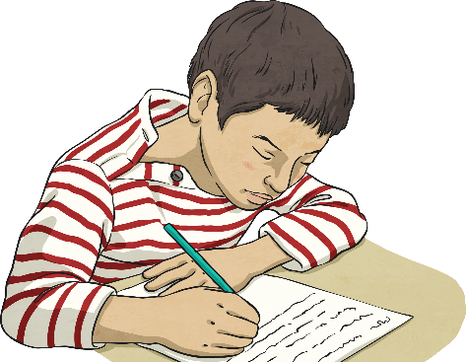
Beliefs
Christians believe that God is Father, Son and Holy Spirit quite separately but all at the same time. This is called the Trinity. To some people this can be quite a confusing idea.
It can be simplified in the following way.
Katie in Year 6 is a daughter. She is also a sister. She is also a cousin. When Katie is a daughter she does not stop being a sister or a cousin. She is all three of these ‘persons’ at the same time but is still just one person – Katie.
Can you think of a similar example?
How does your example help to explain the idea of the Trinity?

Slide 7

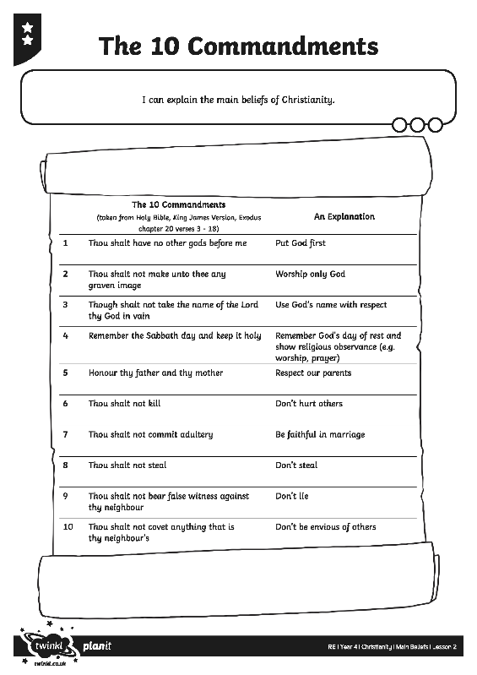
The Ten Commandments
The Ten Commandments are rules from God that Christians live by.
These rules were given in the Old Testament
(the first part of the Bible,
before Jesus was born).
Do all the commandments make sense to you?
Do any of the commandments surprise you?
Why does some of the language in the commandments need explaining?

Slide 8
The Ten Commandments
In your groups create a freeze frame that show one of the Ten Commandments for the rest of the class to guess.

Slide 9

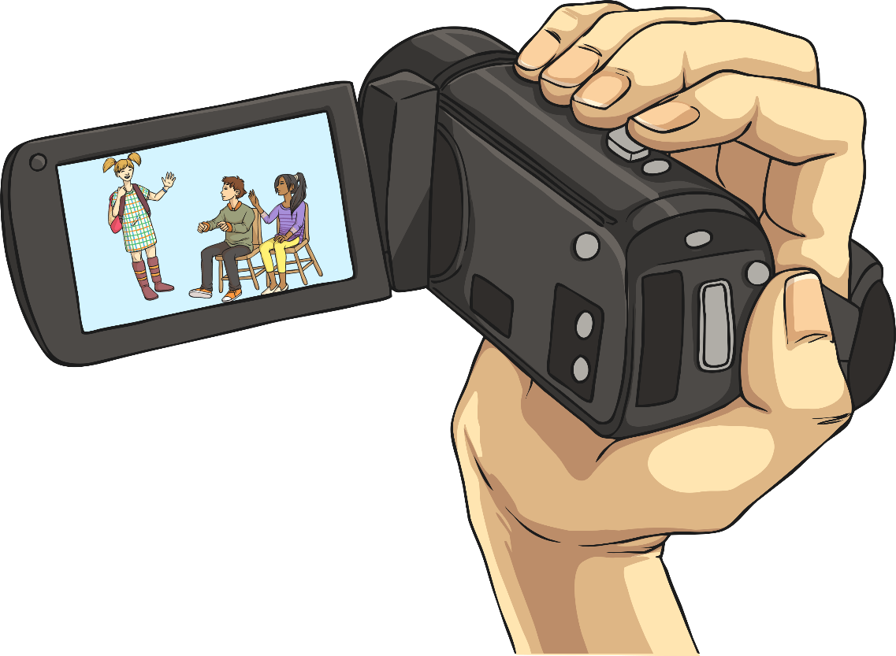
Guess the Commandment
Act out your freeze frame or role play!
Can the rest of the class guess your commandment?
How did you know which commandment was being acted out?

