Slide 1
Learning Objective & Success Criteria
To understand the ‘Holy Trinity’ in Christianity
You will be able to name the three parts of the Trinity
You will have asked and answered some questions about the Holy Trinity
You will have designed a symbol to help remember the Holy Trinity

Slide 2
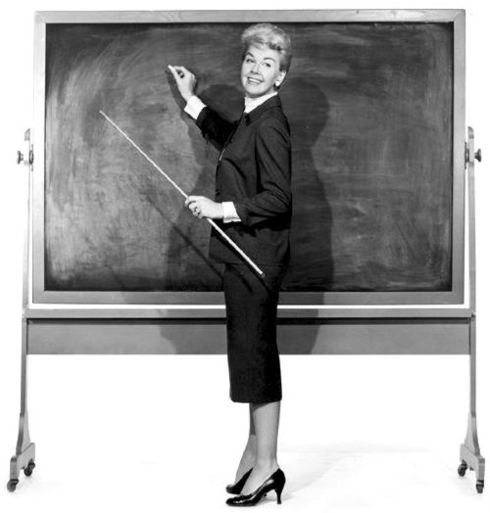
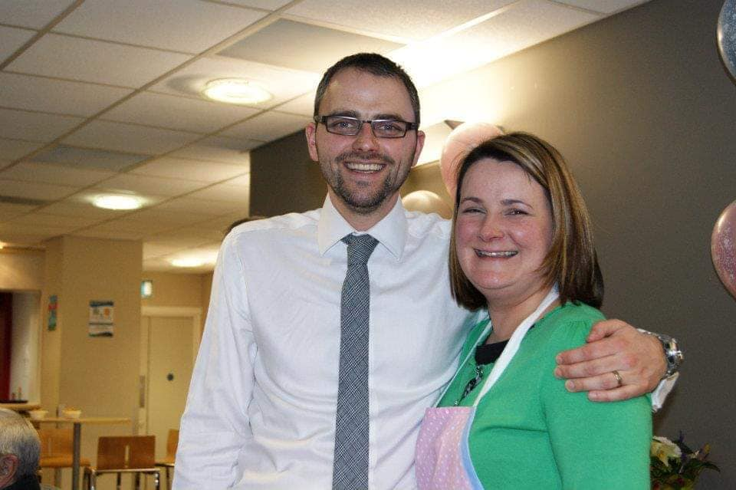

What Different Things are You?
Miss Bibby is:
A Mummy
A teacher
A sister

Slide 3
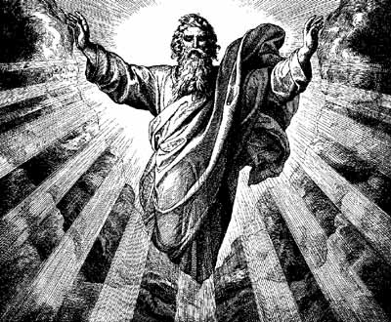
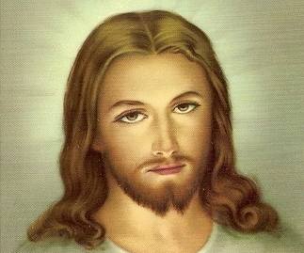
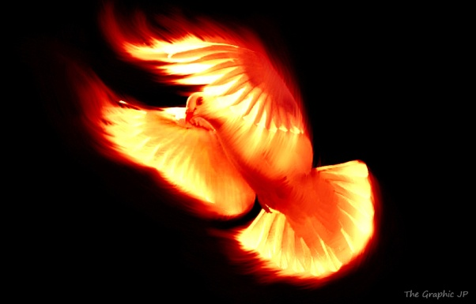
What is the Trinity?
The Trinity is God.
God the Father, God the Son and God the Holy Spirit.
There is only one God.
There are three distinct persons.
Each person is God.
There is only one God.

Slide 4
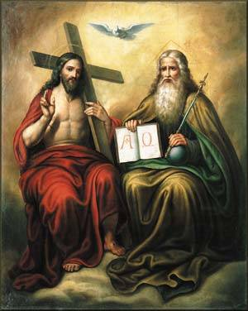
What?
This can be very confusing. Even some Christians don’t understand properly.
The Trinity is not 3 Gods joined together.
It is not 3 people joined to make one God.
It is not one God split into 3 parts.

Slide 5
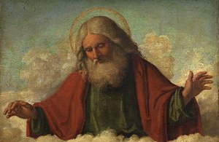
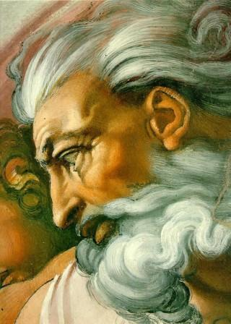
God the Father
Creator of the universe
Father of Jesus
Loving Father of all people
Address as “Our Father”

Slide 6
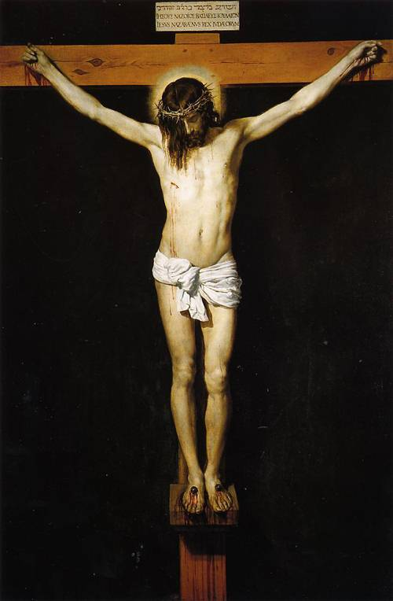
God the Son
Jesus
Has always existed but became human (incarnated) for a time
Shows the human, loving side of God

Slide 7
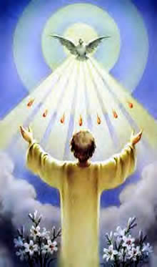
God the Holy Spirit
Can take any form
The giver of life
Lives in people who believe in God
Brings people to God, comforts people, shows people when they are wrong

Slide 8
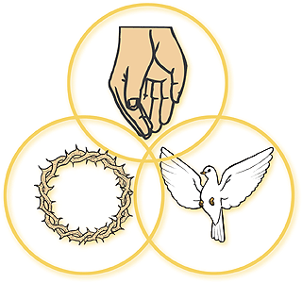
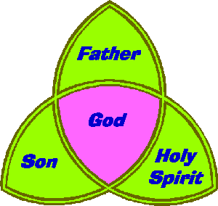


Slide 9
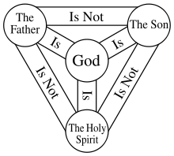
Our Ideas and Questions
At least 5 questions
How
Where
What
When
Why
Work in a group and think of 5 questions that you would like to be answered

Slide 10
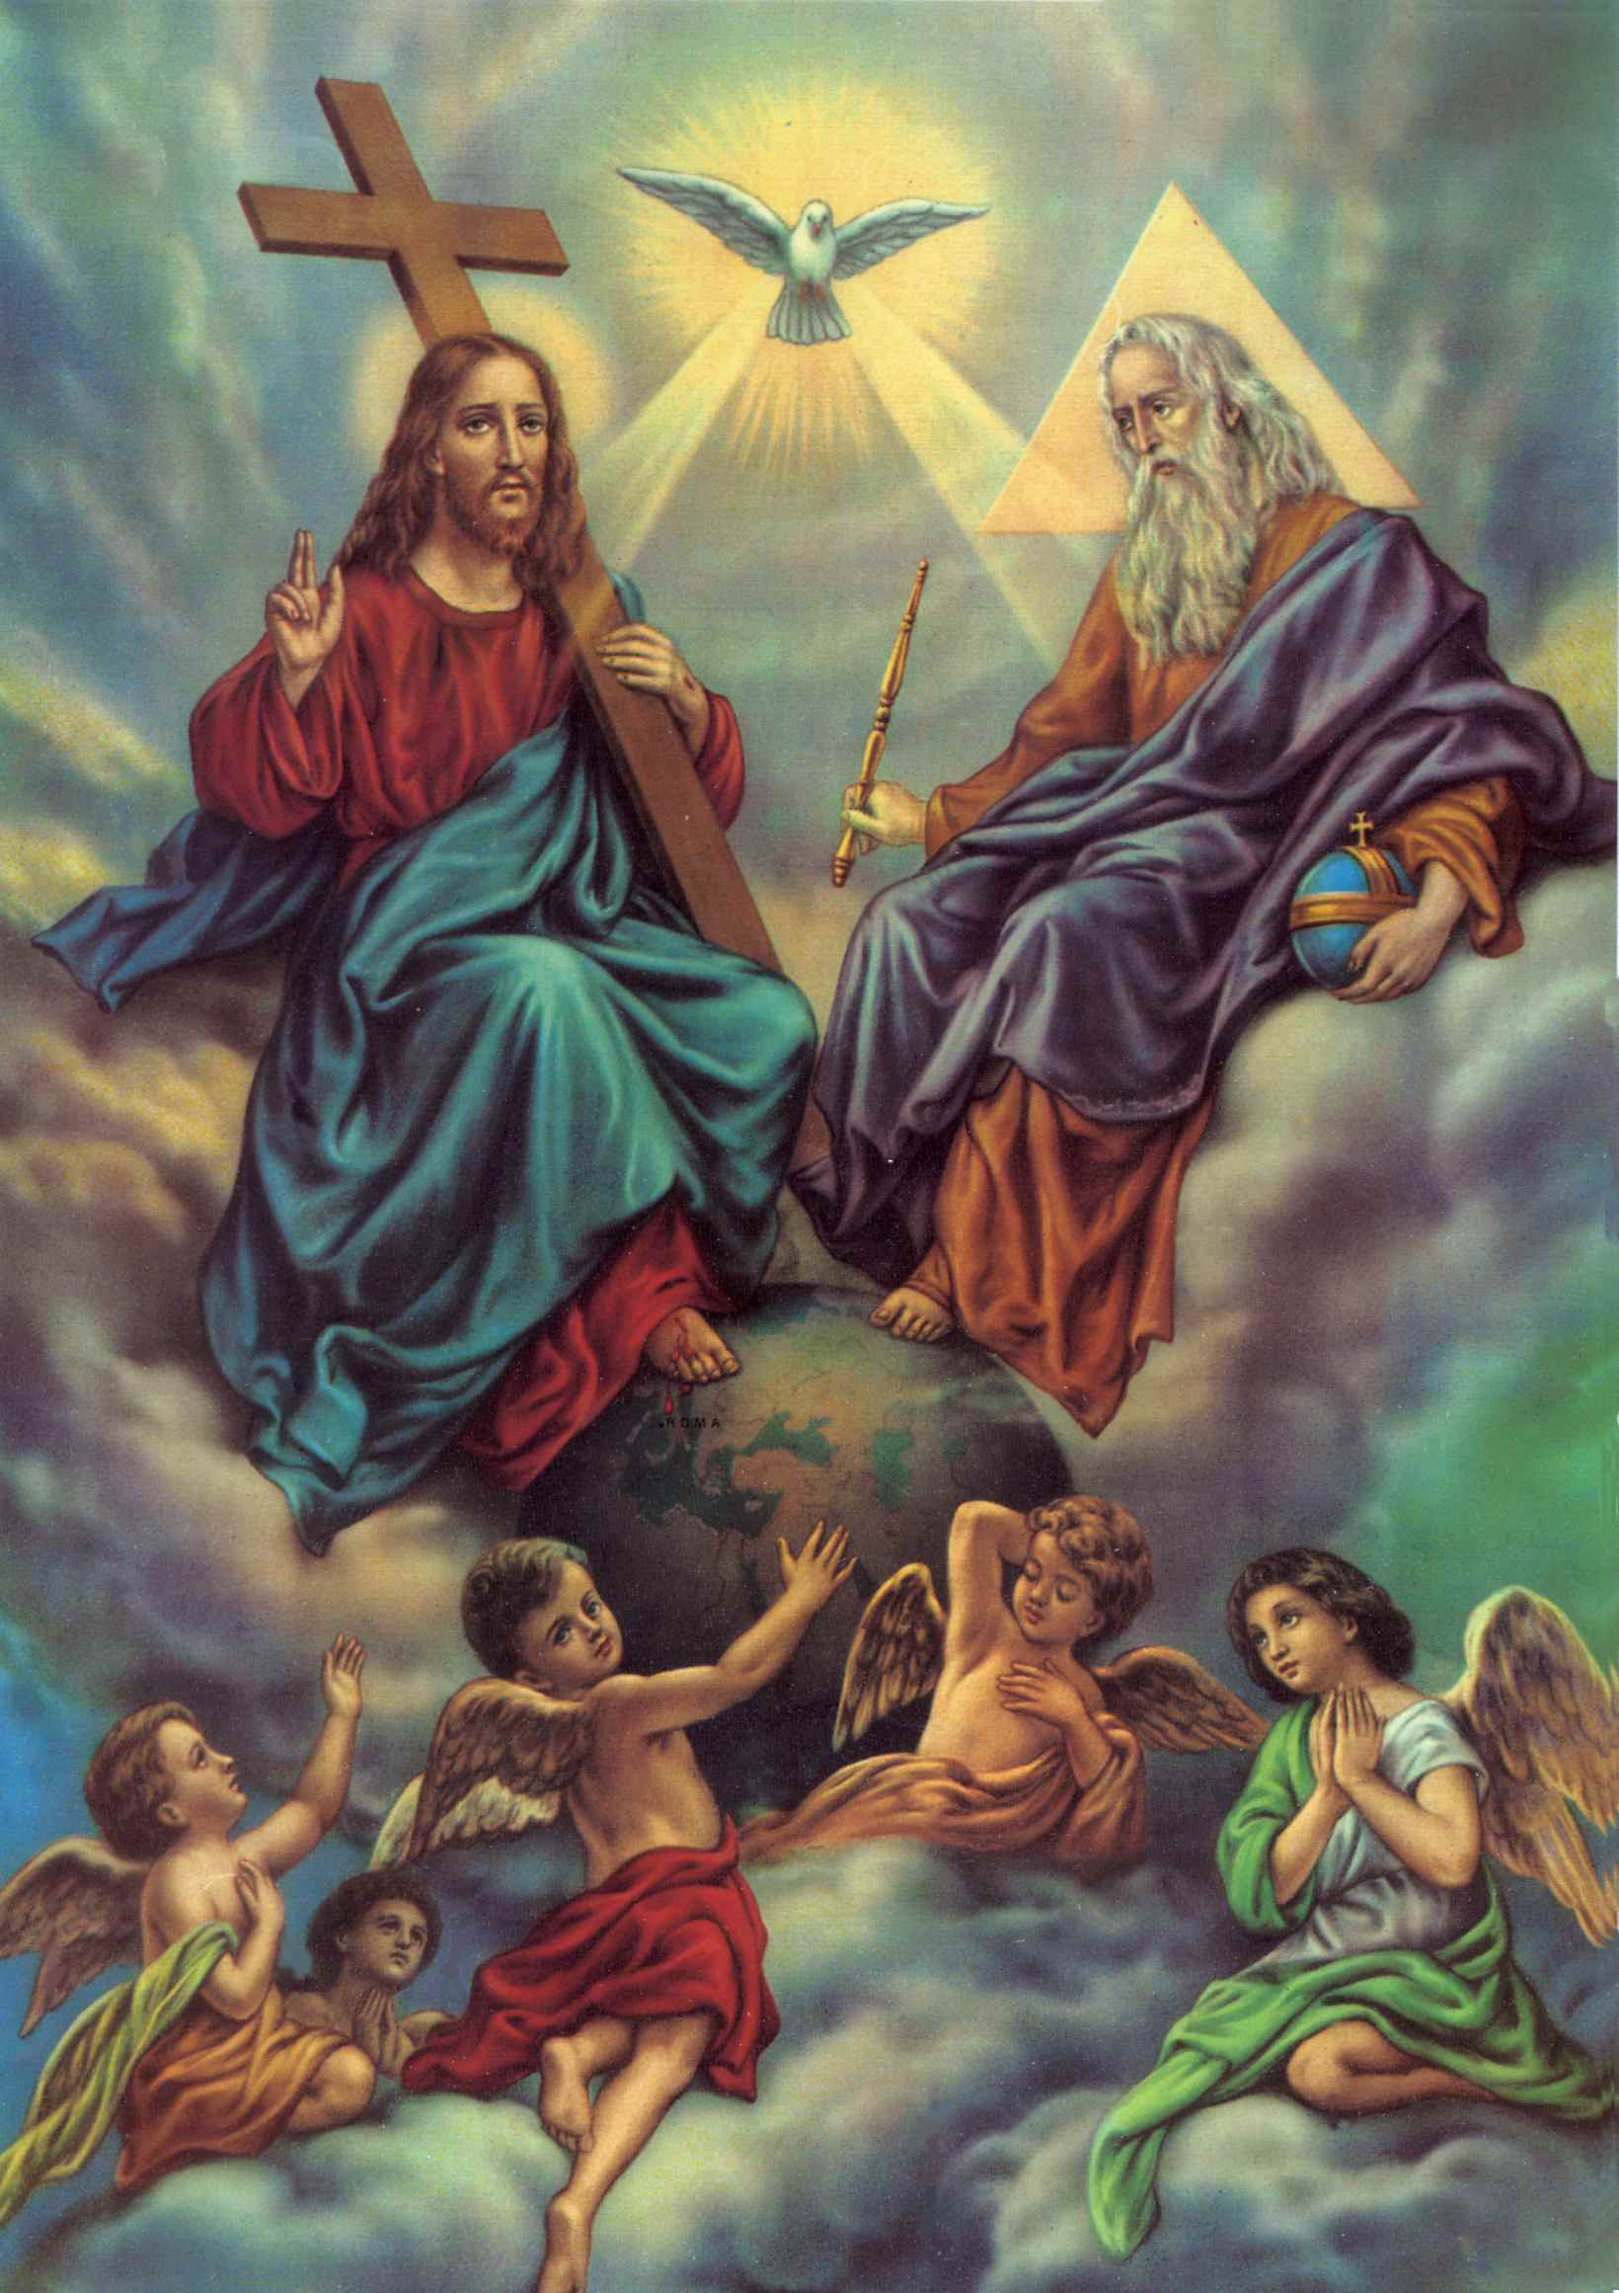
Tell Miss Bibby
Write a short paragraph to Miss Bibby explaining the Holy Trinity
Try and include as much information as you can

Slide 11


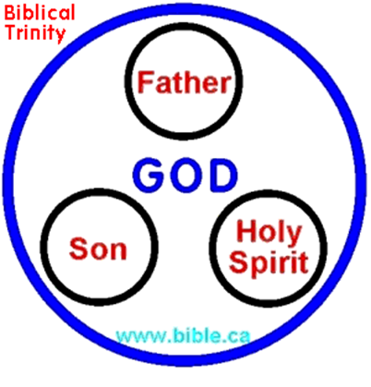
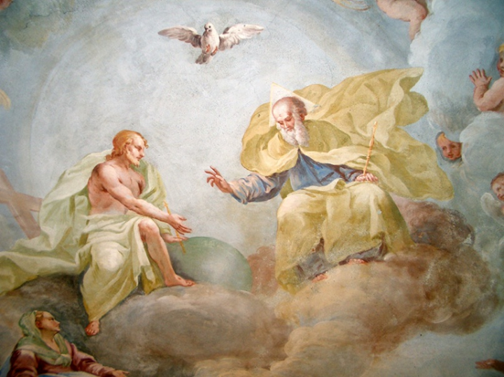
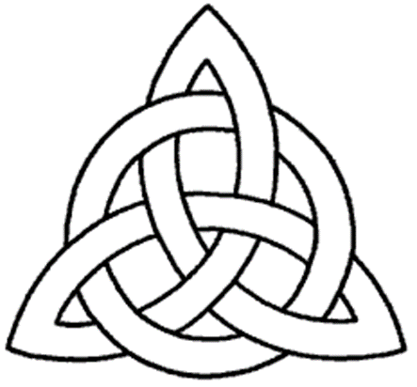
Draw
Can you draw a picture in your book that shows the Holy Trinity? How might you remember it?

Slide 12
How do you feel about the Holy Trinity?
I understand the Holy Trinity
I maybe understand the Holy Trinity and need some more help
I don’t understand the Holy Trinity at all

